Slide 1

IOT Based Weather Monitoring and Reporting System Project
KOWSALYA S (7376211CS190)
DHIVYA PRASATH K (7376211CS144)
DHARSHAN S (7376211CS139)
MALINI V (7376211CS201)

Slide 2


ABSTRACT
The IOT based Weather Monitoring and Reporting System project is used to get Live reporting of weather conditions. It will Monitor temperature, humidity, moisture and rain level. Suppose Scientists/nature analysts want to monitor changes in a particular environment like volcano or a rain-forest. And these people are from different places in the world. In this case, SMS based weather monitoring system has some limitations. Since it sends SMS to few numbers. And time for sending SMS increases as the number of mobile numbers increases. In order to know the information about weather of a particular place then they have to visit that particular sites. Where everyone can see it.

Slide 3

PROBLEM STATEMENT In recent times farming is facing many issues on problems like cropping pattern, weather conditions, humidity, temperature and moisture content in the air. This is mainly due to lack of modern technologies like internet of things (iot). There is inefficiency in identifying the problems faced by the farmers during the gestation period in a shorter span of time. Monitoring of changes happening in the environment is also difficult for the scientists/nature analysists. but theses people for from vast areas. so, it is very hard to collect/know the information about the weather of a particular place. Hence it becomes harder for the scientists to analyse the weather and forecast reports for live updates. In this world sms based weather monitoring system is also difficult.

Slide 4
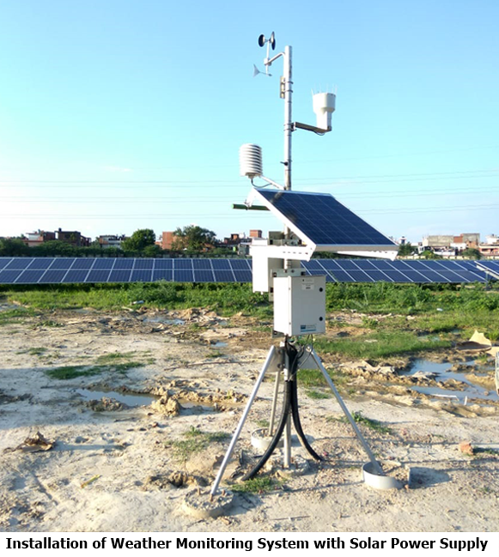
Existing Solution to the Problem Addressed
The system consists of temperature and humidity sensor(DHT 11) and CO sensor. These 2 sensors will measure the primary environmental factors temperature, humidity and the CO levels. All this sensors will gives the analog voltage representing one particular weather factor. The microcontroller will converts this analog voltage into digital data.

Slide 5
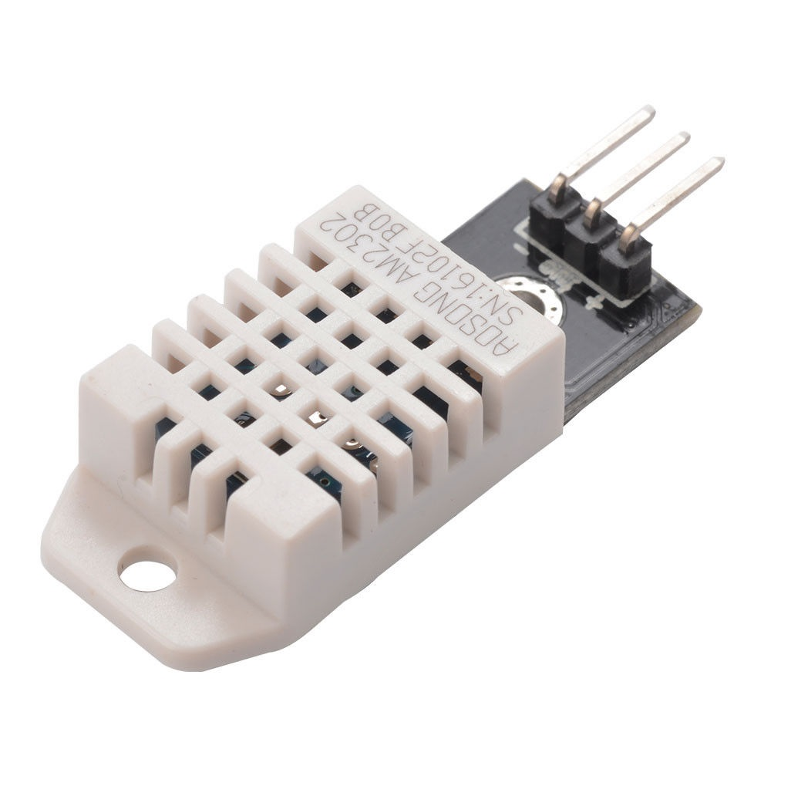
Proposed Solution to the Problem Addressed
TEMPERATURE SENSOR AND HUMIDITY SENSOR
The DHT11 is an essential, ultra minimal effort
computerized temperature and humidity sensor.
It utilizes a capacitive humidity sensor and a thermistor
to gauge the surrounding air, and releases a digital data on the data pin (no analog information pins required).
The main genuine drawback of this sensor is you can just
get new information from it once every 2 seconds, so when utilizing our library, sensor readings can be up to 2 seconds old.
It works on 3 to 5V power supply. Good for 20- 80%
humidity readings with 5% accuracy and for 0-50°C temperature readings ±2°C accuracy

Slide 6
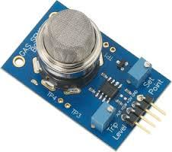
Proposed Solution to the Problem Addressed
CARBON MONOXIDE (CO) SENSOR
Carbon Monoxide (CO) sensor, suitable for sensing CO concentrations in the air. Carbon monoxide sensor, suitable for sensing CO concentration in air. The MQ-6 can sense CO-gas concentration somewhere in the range of 20 to 2000ppm. This sensor has a high affectability and quick reaction time. The sensor's yield is analog resistance. The drive circuit is exceptionally straightforward; you should simply control the heater curl with 5V, include a load resistance, and associate the output to an ADC.
Conversion factors 1 ppm= 1.145 mg/m3
1 mg/mg = 0.873 ppm

Slide 7
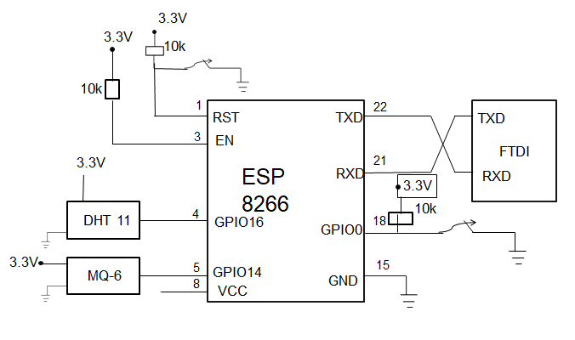
Circuit Diagram
According to its developers, “Thing Speak” is an open source Internet of Things (IOT) application and API to store and retrieve data from things using the HTTP protocol over the Internet or via a Local Area Network. Thing Speak enables the creation of sensor logging applications, location tracking applications, and a social network of things with status updates". Thing Speak has integrated support from the numerical computing software MATLAB from MathWorks allowing Thing Speak users to analyse and visualize uploaded data using MATLAB without requiring the purchase of a MATLAB license from MathWorks.

Slide 8

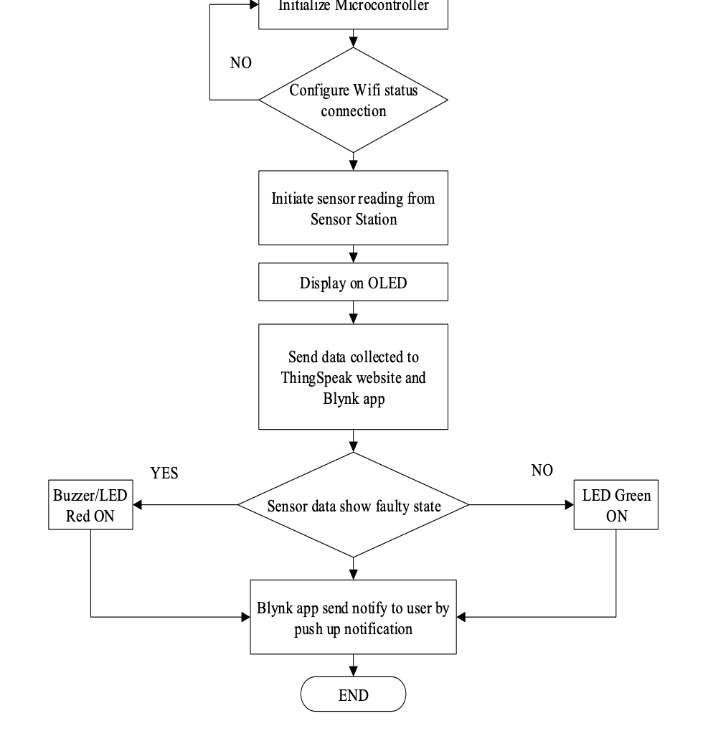
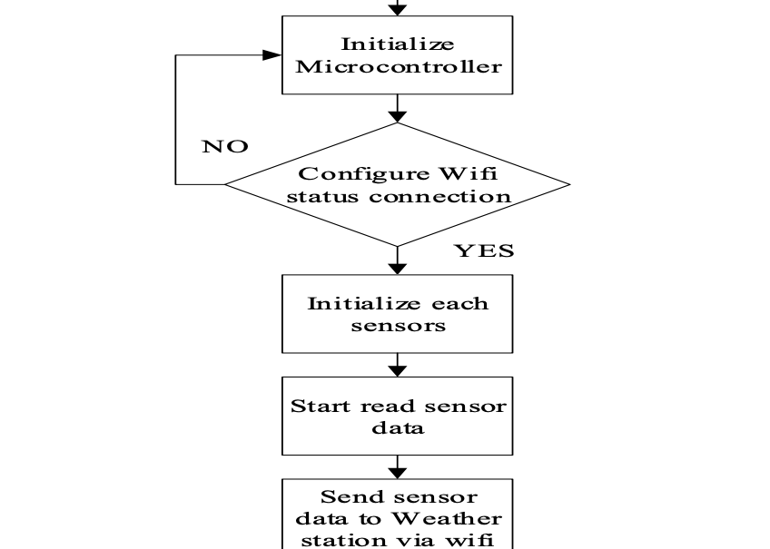
CONTROL UNIT FLOWCHART
MONITORING UNIT FLOWCHART

Slide 9
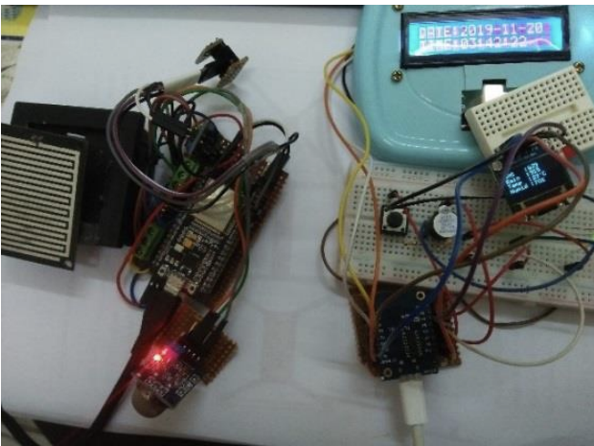
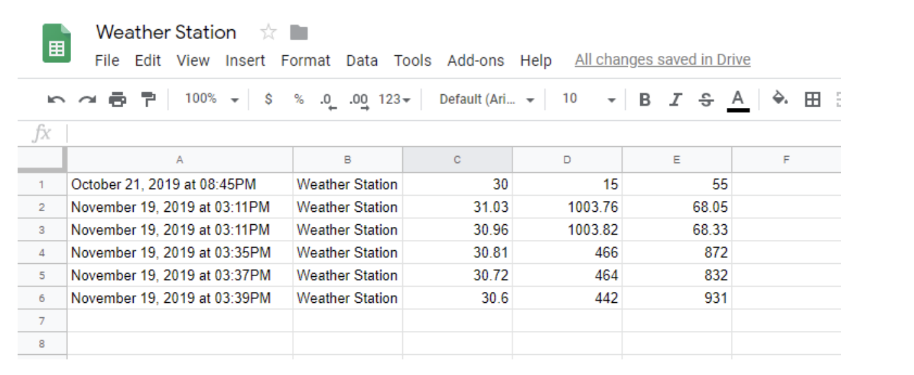
Effective utilization of the Modern Tool & Cloud
Full circuit for Sensor station and Weather station displaying sensor data.
This data is received from sensor station, with ESP32 will send the weather parameters data to google sheet

Slide 10
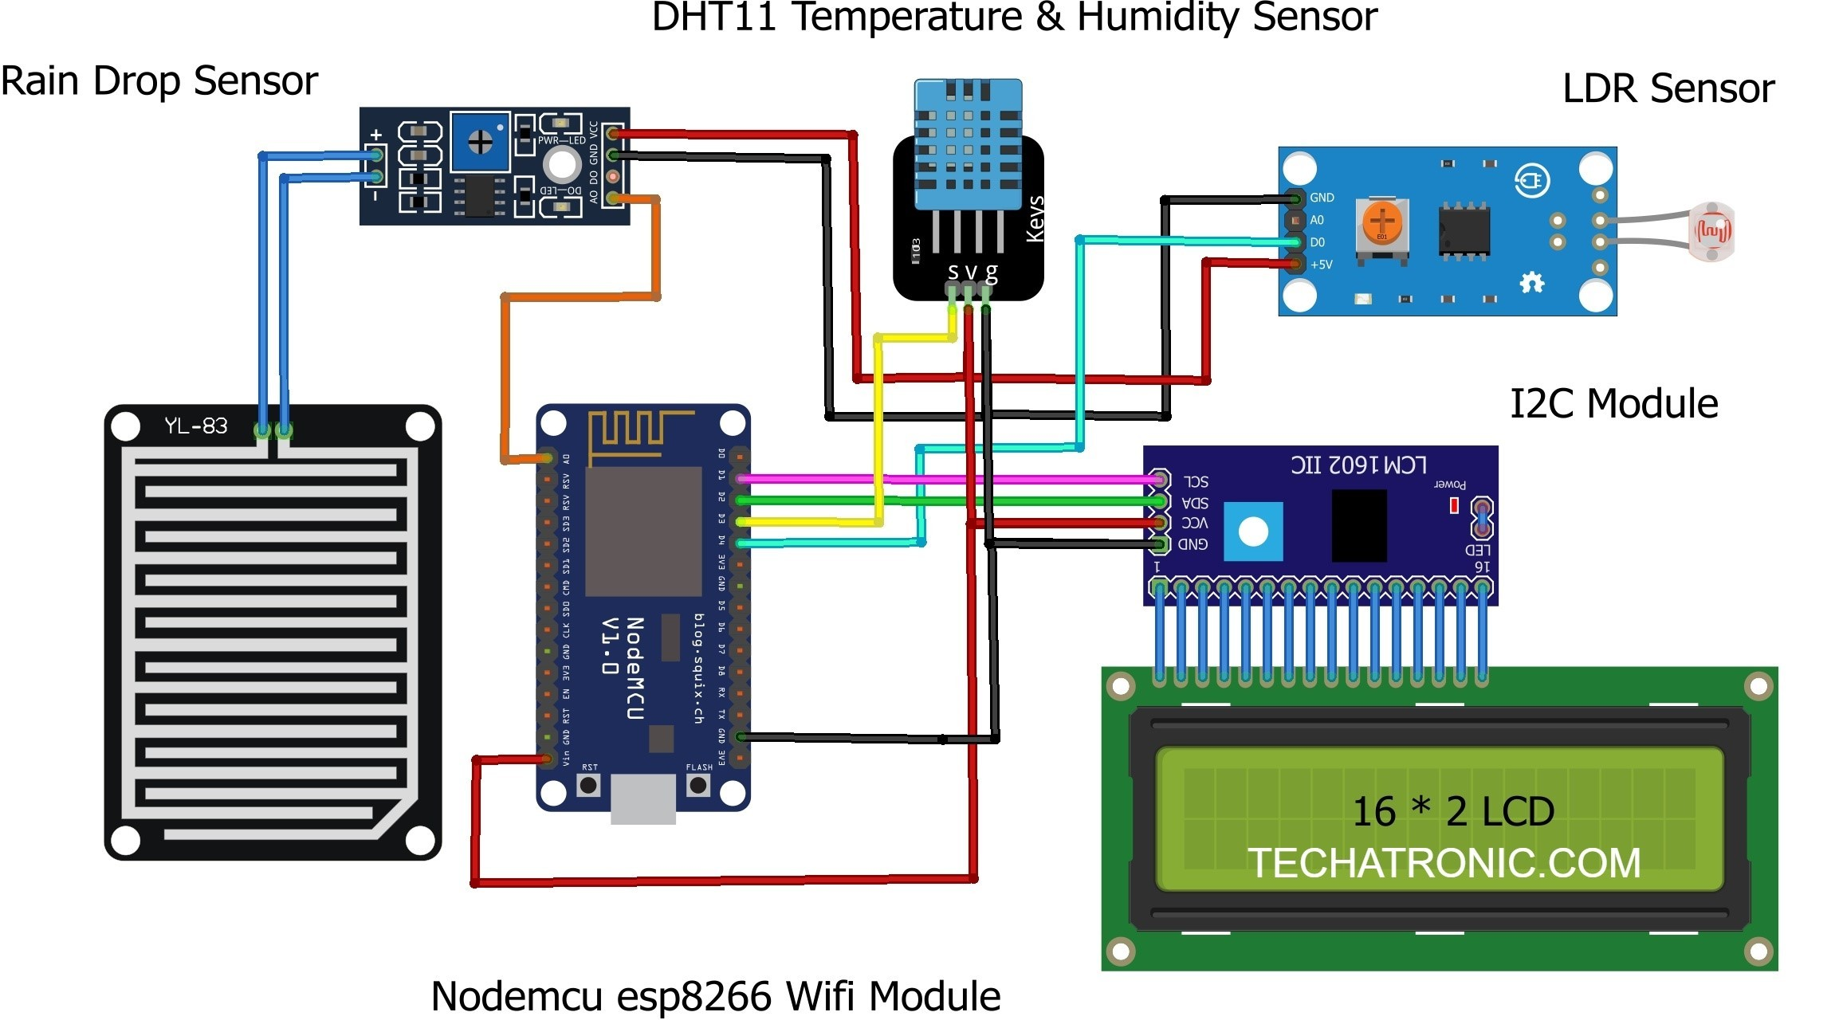
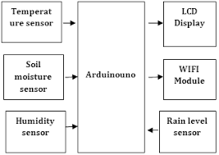
Technology stack & use case

Slide 11
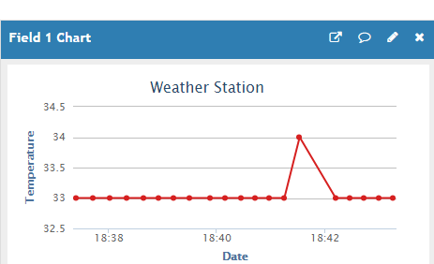
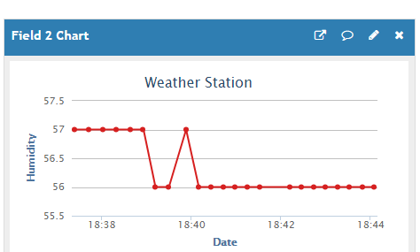
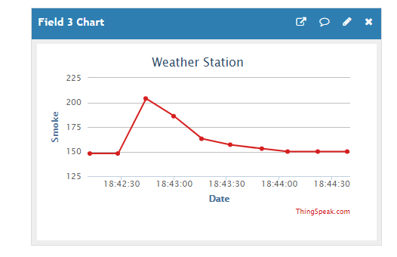
Simulation of Temperature v/s Time
Simulation of Humidity v/s Time
Simulation of Smoke content v/s Time

Slide 12
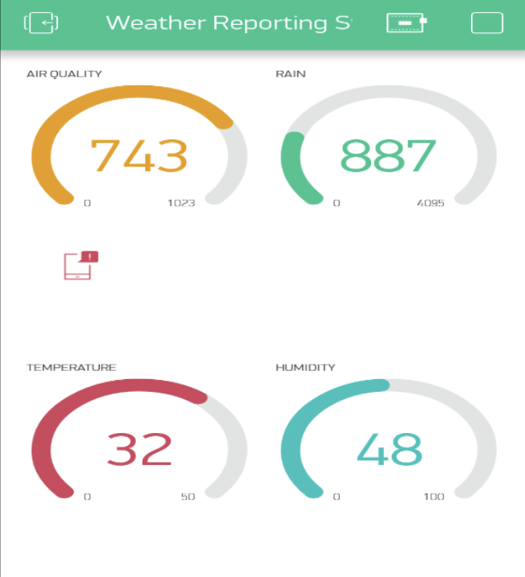
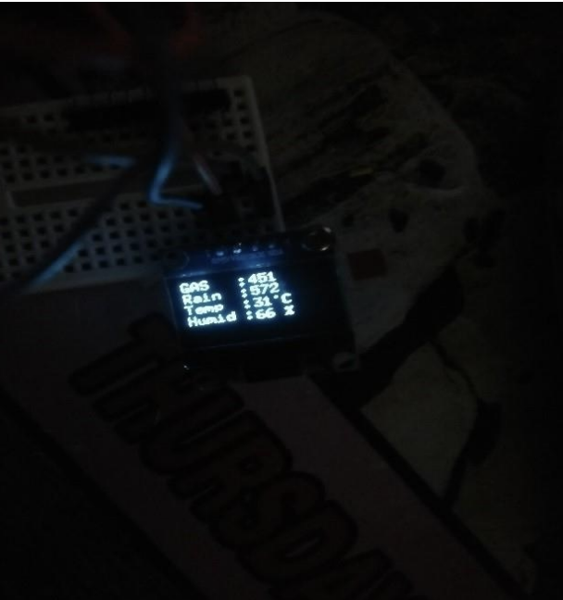
Prototype & Sample Output
As this android app is free to build by download it on Google Play store and register with email to use the app. By some setting with the app to configure the hotspot connection of internet then specify each weather parameter into the app widget setting.(Blynk display data)
OLED display sensor data send by ESP32 via hotspot

Slide 13
Analysis of Results & Discussions
=> By keeping the embedded devices in the environment for monitoring enables self protection (i.e., smart environment) to the environment.
=> To implement this need to deploy the sensor devices in the environment for collecting the data and analysis. By deploying sensor devices in the environment, we can bring the environment into real life i.e. it can interact with other objects through the network.
=> Then the collected data and analysis results will be available to the end user through the Wi-Fi. The smart way to monitor environment and an efficient, low cost embedded system is presented with different models in this paper. In the proposed architecture functions of different modules were discussed.
The temperature, humidity and CO value can be monitored with Internet of Things (IoT) concept
experimentally tested for monitoring three parameters. It also sent the sensor parameters to the cloud (Google Spread Sheets).
This data will be helpful for future analysis and it can be easily shared to other end users.
This model can be further expanded to monitor the developing cities and industrial zones for weather monitoring. To protect the public health from pollution, this model provides an efficient and low cost solution for continuous monitoring of environment.

Slide 14
REFERENCES
[1] E. Welbourne, L. Battle, G. Cole, K. Gould, K. Rector, S. Raymer et al., “Building the internet of things using RFID: The RFID experience,” IEEE internet comput., vol. 13, no. 3, pp.48- 55, May- Jun. 2009.
[2] Shifeng Fang; Li Da Xu; Yuanjiang Zhu; JiaerhengAhati; Huan Pei; Jianwu Yan; Zhihui Liu., “An integrated system for regional environmental monitoring and management based on internet of things”, IEEE Transactions on Industrial Informatics,vol.10, no. 2,pp.1596-1605, May-Jun. 2014.
[3] J. A. Stankovic, “Research directions for the Internet of Things,” IEEE Internet Things'., vol. 1, no. 1, pp. 3–9, Feb. 2014
[4] Shanzhi Chen; HuiXu; Dake Liu; Bo Hu; Hucheng Wang.
[5] L. Atzori, A. Iera, and G. Morabito, “The internet of things: A
survey,” Comput. Netw., vol. 54, no. 15, pp. 2787–2805, 2010
[6] P. Bellavista, G. Cardone, A. Corradi, and L. Foschini,“Convergence of MANET and WSN in IoT urban scenarios,”IEEE Sens. J., vol. 13,
no. 10, pp. 3558–3567, Oct. 2013.

Slide 15


THANK YOU

